Slide 1
Unit 4
Inflation and unemployment

Slide 2
OUTLINE
Introduction
What is the problem with inflation?
Inflation and unemployment
Causes of inflation

Slide 3
A. Introduction

Slide 4
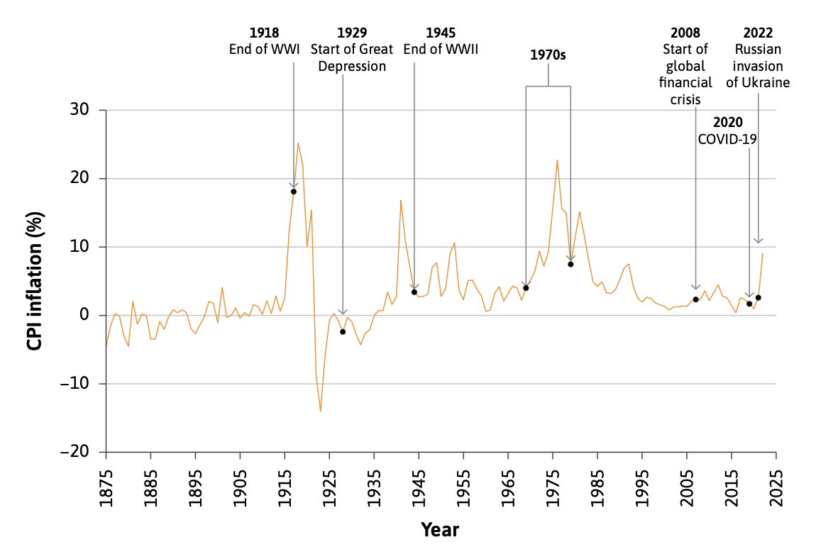
The context for this unit

Slide 5
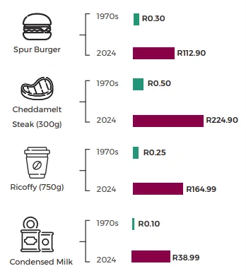
Inflation in South Africa
Where do you see the most inflation (in which products)?
Notes:
Infographic is from this article: https://dailyinvestor.com/finance/90745/spur-burger-and-steak-for-80-cents/
Inflation in coffee prices: https://businesstech.co.za/news/lifestyle/821909/bad-news-about-coffee-prices-in-south-africa/
Inflation in clothing: https://fastcompany.co.za/business/2025-07-17-south-africas-retail-sales-growth-is-driven-by-low-inflation/
Ask students when they have seen inflation.

Slide 6
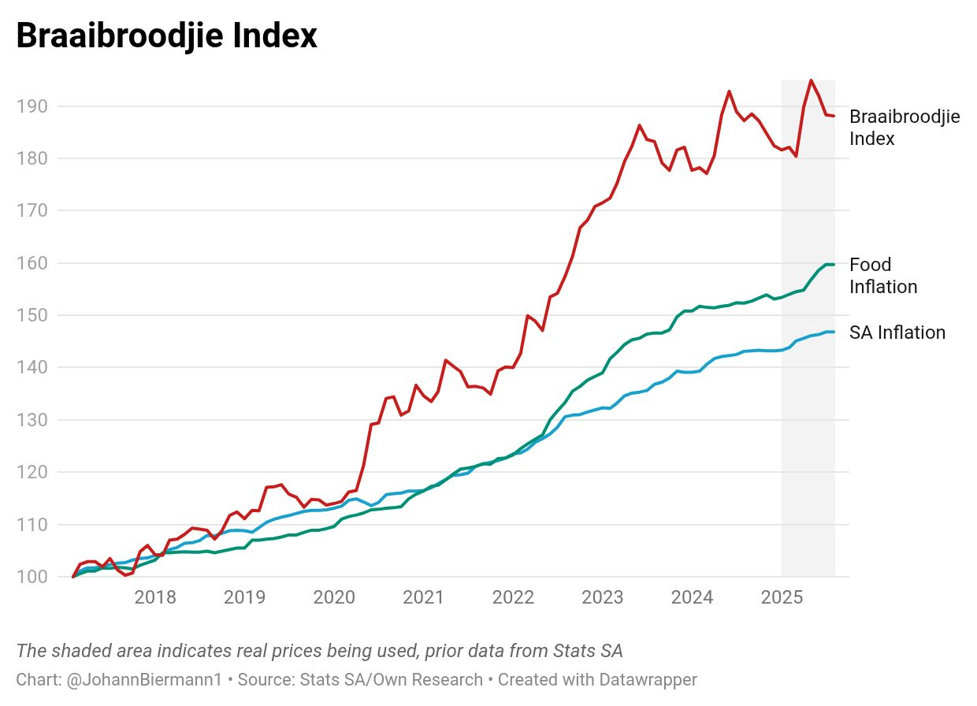
Inflation in South Africa – Braaibroodjie Index
The Braaibroodjie Index is an insightful measure of food inflation created by SA economist Johann Bierman, based on the cost of ingredients for a classic braaibroodjie (bread, cheese, tomato, onion, chutney, salt, pepper).
The index uses a familiar staple to track rising food prices, making inflation data relatable to everyday South Africans.
Inflation link: The Braaibroodjie Index can be compared with official food inflation and overall CPI inflation to show how specific food items experience different price pressures.

Slide 7
This unit
Discuss how consumer price inflation is measured and why inflation creates ‘winners’ and ‘losers’
Explain how the Phillips curve summarizes the relationship between unemployment and inflation
Describe the connections between the WS-PS model, inflation, and aggregate demand

Slide 8
B. What is the problem with inflation?

Slide 9
Measuring inflation
Inflation is a general increase in prices across the economy.
The commonly used ‘consumer price inflation’ is measured by the percentage increase in the cost of a representative basket of household goods and services, usually over a year.
The consumer price index (CPI) measures the general level of prices that consumers pay for goods and services, including consumption taxes.
The basket of goods and services is chosen to reflect the spending of a typical household in the economy. For this reason, the change in the CPI, or CPI inflation, is often considered to measure changes in the ‘cost of living’.

Slide 10
The Consumer Price Index (CPI)
The CPI is based on what consumers actually buy. The goods and services in the basket are weighted according to the fraction of household spending they account for. The CPI excludes exports but, includes imports
To calculate the rate of inflation, there are three steps:
Find the cost of the basket of goods,
Compute a price index such as the CPI,
Use the CPI to calculate the inflation rate.

Slide 11
Calculating the CPI: an example
 |  | 2020 |  | 2021 |  | 2022
Good | Quantity | Unit price | Total cost | Unit price | Total cost | Unit price | Total cost
Bags of rice | 2 | R10 | R20 | R12 | R24 | R13 | R26
Pieces of chicken | 5 | R3 | R15 | R5 | R25 | R8 | R40
Carrots | 20 | R0.50 | R10 | R0.75 | R15 | R1 | R20
Cost of basket |  |  | R45 |  | R64 |  | R86

Slide 12
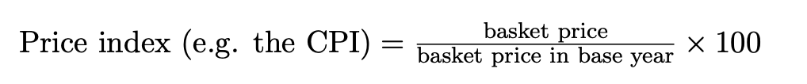
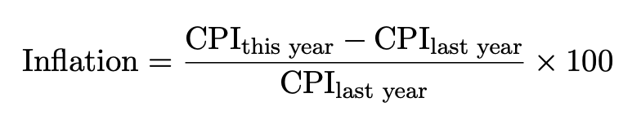
Calculating the CPI: an example
 | 2020 | 2021 | 2022
Basket price | R45 | R64 | R86
Basket price in base year (2020) | R45 | R45 | R45
CPI | 100 | 142.22 | 191.11

Slide 13
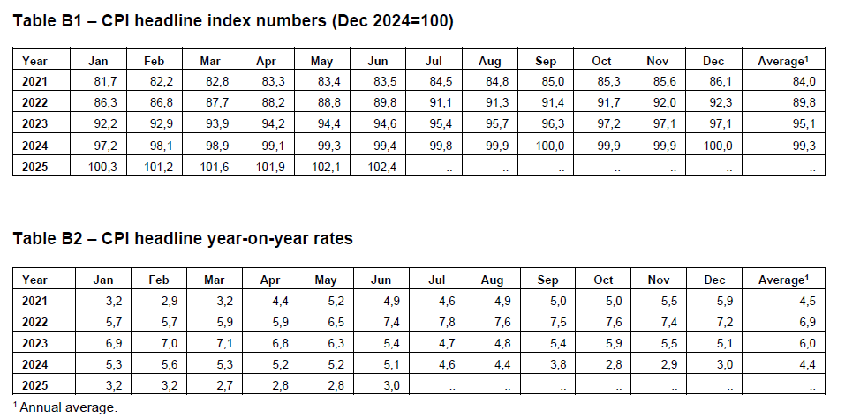
South Africa’s CPI
Notes:
Source: August 2025

Slide 14
Class Exercise
Which of the following statements is CORRECT based on South Africa’s CPI? Answers are rounded to two decimals.
a) South Africa experienced year-on-year deflation November 2024.
b) South Africa experienced year-on-year deflation March 2022.
c) Month-on-month inflation for February 2024 was 0.93 %
d) Month-on-month inflation for February 2024 was 5.6%

Slide 15
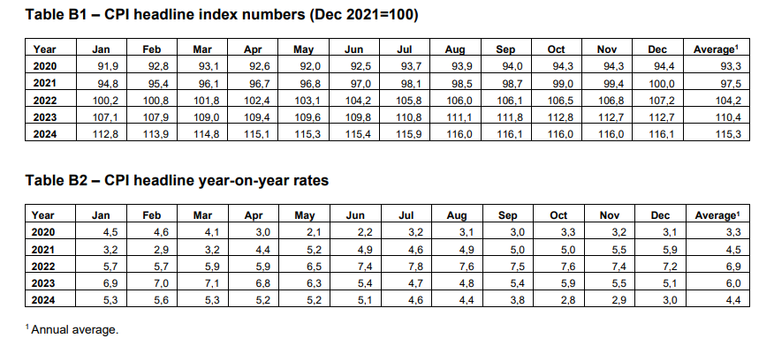
South Africa’s CPI

Slide 16
The GDP deflator
The GDP deflator is a price index like the CPI, but it tracks the change in prices of all domestically produced final goods and services.
Instead of a basket of goods and services that a consumer buys, the GDP deflator tracks the price changes of the components of domestic GDP, that is, of C + I + G + X – M.
It includes exports, but excludes imports.
The GDP deflator can also be expressed as the ratio of nominal (or current price) GDP to real (or constant price) GDP.
The GDP deflator series is most commonly used to transform a nominal GDP series into a real GDP series.

Slide 17
Changes in the price level
Inflation: The price level is rising (positive CPI change).
Deflation: The price level is falling (negative CPI change).
Disinflation: The inflation rate is falling (scale of positive CPI change reducing).

Slide 18
What’s wrong with inflation?
Inflation matters when it affects real incomes.
There are winners and losers from inflation, depending on what people consume; the source of their income (wages, profits, or transfers, for example); how quickly wages, benefits, and interest rates adjust to price increases; and whether a household is a net lender or borrower.
Winners: Borrowers, people with flexible incomes.
Losers: Savers, fixed income earners, pensioners
Why? Inflation erodes the purchasing power of money.
Moreover, inflation is costly even to those whose real incomes increase, because it makes future prices uncertain, exposing people to risks, which make them feel worse off.
However, a stable low level of inflation can be a good thing.

Slide 19
What about deflation?
A sustained fall in the price level is undesirable for many of the same reasons that inflation is undesirable. And there are other problems as well.
When prices are falling, households will postpone consumption (particularly of expensive items such as fridges, screens, and cars) because they expect goods will be cheaper in the future.
A prolonged recession caused by weak aggregate demand is a likely cause of deflation. This would be exacerbated if spending decisions are postponed.

Slide 20
C. Inflation and unemployment

Slide 21
Inflation and unemployment
At the heart of the process of inflation is the conflict of interest between workers and owners over the share of output per worker each group gets—the wage share and the profit share.
In the WS–PS model the conflict is resolved at a particular level of employment on the horizontal axis where the WS curve and the PS curve intersect. The unemployment rate associated with this intersection is the economy’s structural unemployment rate.
To the right of the intersection, where employment is higher, unemployment is lower than the structural rate and wages and prices tend to rise; and on the left, where unemployment is higher, they tend to fall.
This provides the intuition behind the Phillips curve, which relates the unemployment rate to the rate of inflation.

Slide 22
A reminder about firms
Suppose we have an economy composed of many identical firms (each of which is owned by a single individual) and their employees, who are also the consumers of the goods produced by the firms.
The HR department in each firm sets the nominal wage for its workers at the level required to recruit sufficient workers and motivate them to work hard—the ‘no-shirking’ wage. When divided by the price level in the economy to get the wage in terms of what can be purchased, this is the real wage on the WS curve at the prevailing unemployment rate in the economy.
The marketing department in each firm sets its price as a markup over its marginal cost to maximize its profits, given the degree of competition in the markets in which it sells. The outcome of the price-setting process across the economy can be expressed as a ratio of the nominal wage to the price set. This is the price-setting real wage.

Slide 23
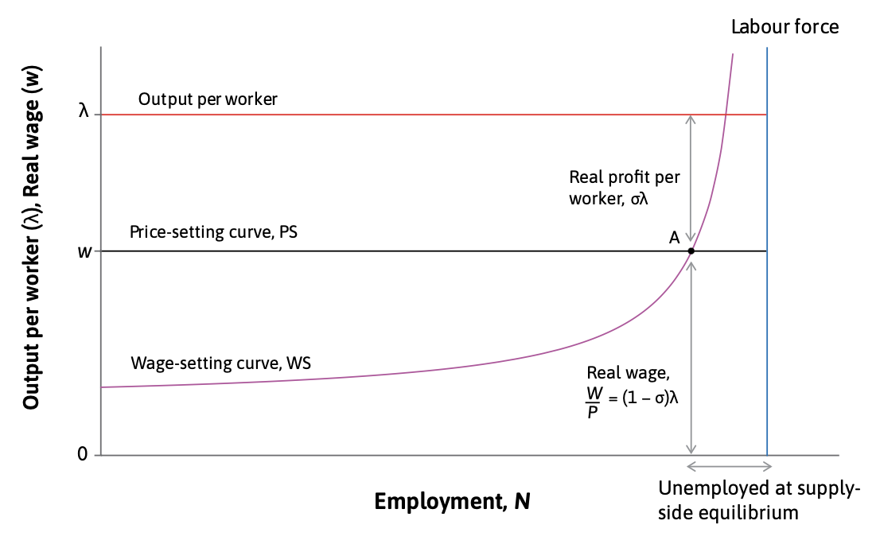
Supply-side equilibrium

Slide 24
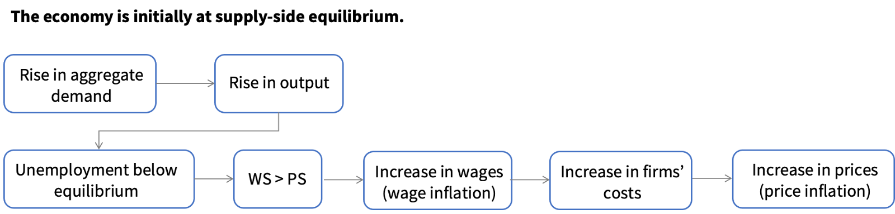
AD, inflation and unemployment
The production function—the relationship between output and the inputs used to produce it is:
𝑌=𝜆𝑁
So, in our simple model, output and employment are directly proportional to each other; when output rises, employment rises in proportion, and unemployment falls.

Slide 25
Deriving the Phillips curve
To understand how inflation comes about in a business cycle upswing, we begin with the economy at the supply-side equilibrium and with constant prices and wages: inflation is zero.
To simplify the calculations, we use an index for the real wage: it is equal to 100 in the initial equilibrium. Then, a rise in aggregate demand reduces unemployment.

Slide 26
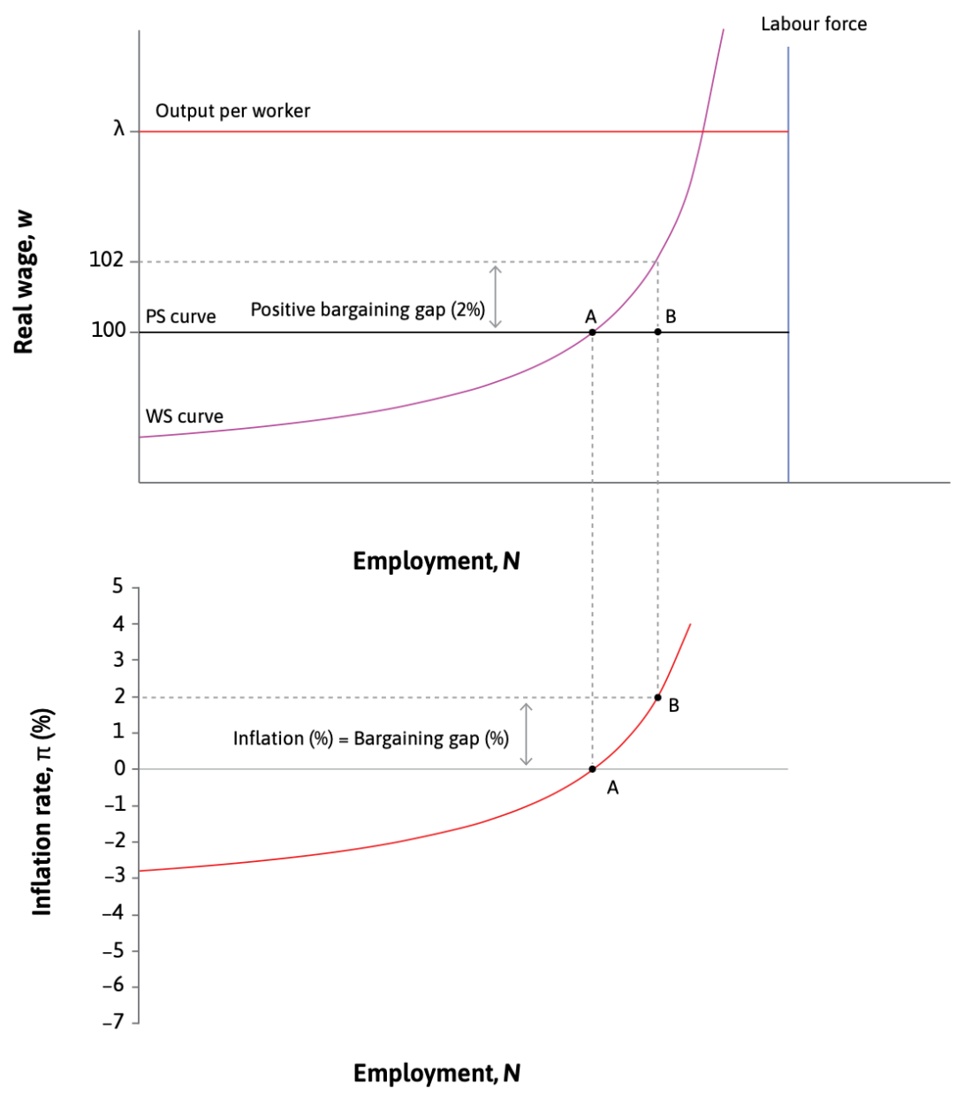
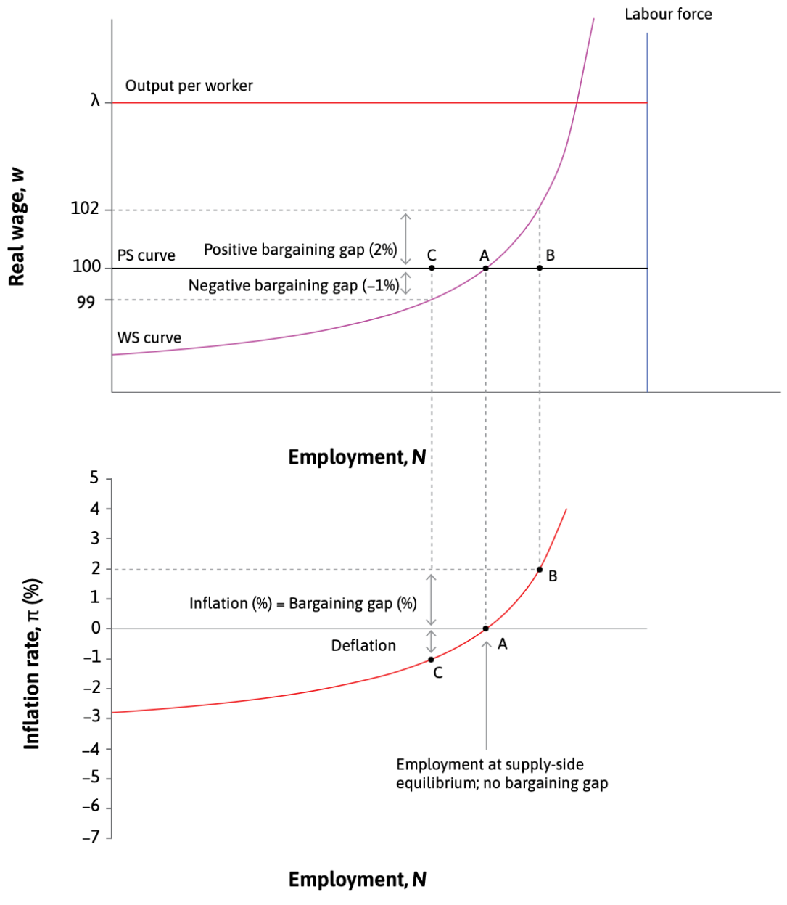
Deriving the Phillips curve

Slide 27
The Phillips Curve
Shows the inverse relationship between unemployment and inflation.
Low unemployment → Higher wages → Firms increase prices → Higher inflation
High unemployment → Wage pressure drops → Lower inflation

Slide 28
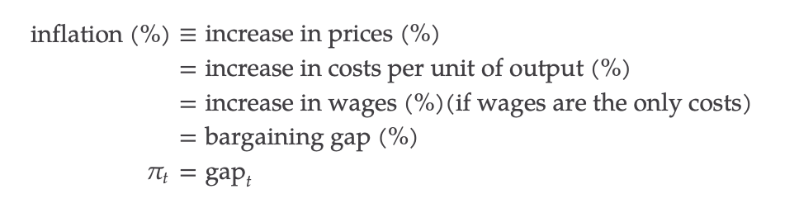
Bargaining gaps and inflation

Slide 29
Expected inflation
Households care about wages and firms care about profits in real terms and consider two points:
People are forward-looking: They take actions now in anticipation of things they expect to happen. To stress this, economists say that ‘expectations matter’.
People treat prices as messages: People treat changes in prices as messages about what will happen in the future, just as people treat a build-up of clouds as a prediction of rain.
The way that people expect inflation to behave will depend on how they make forward-looking decisions and how they interpret price messages.

Slide 30
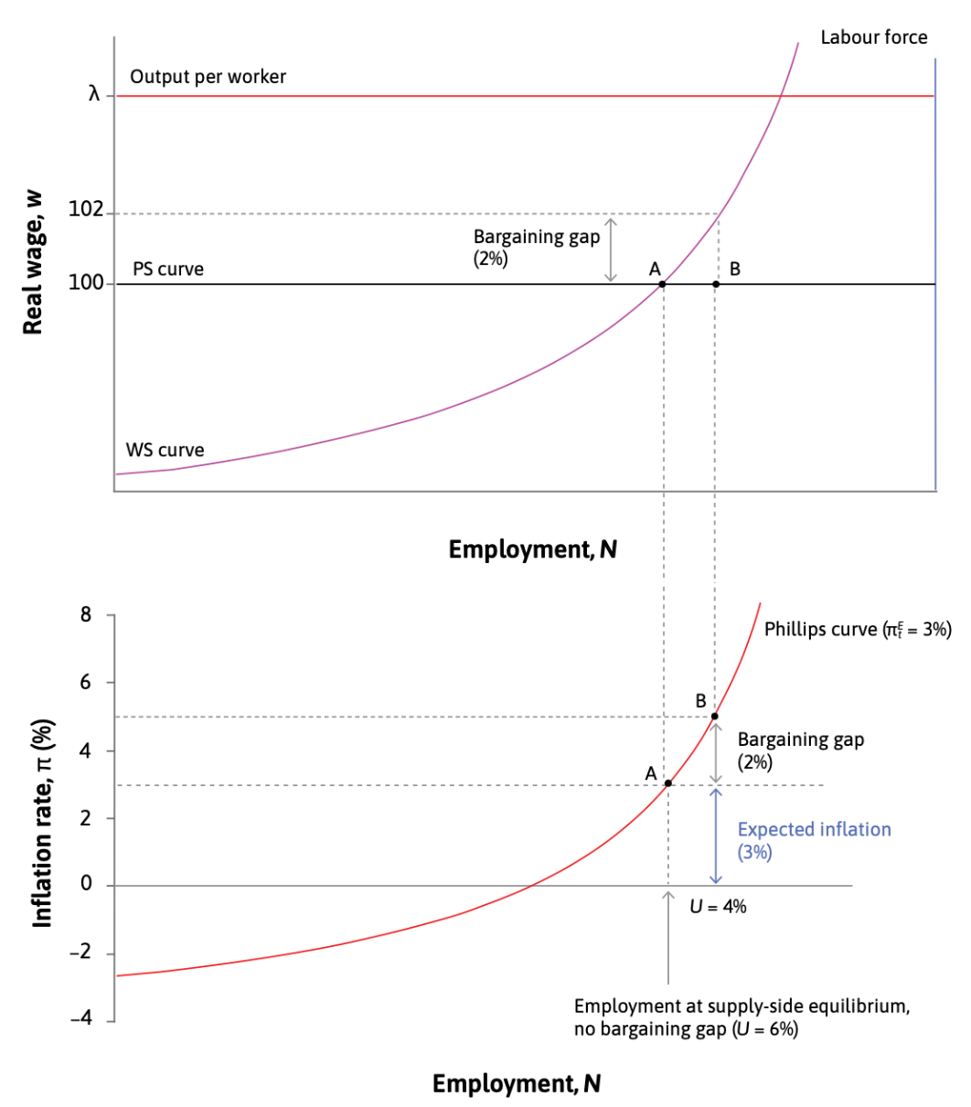
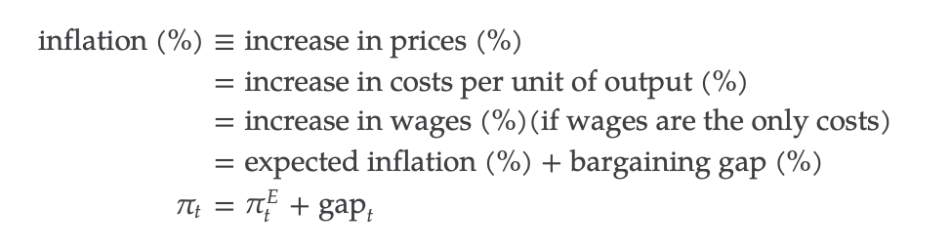
Expected inflation

Slide 31
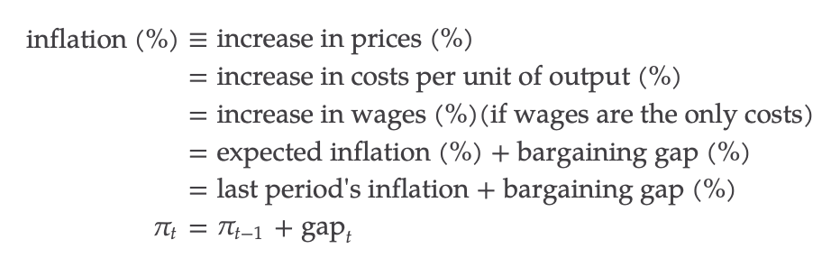
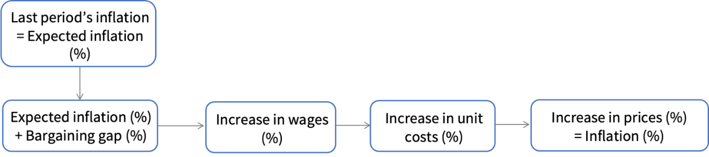
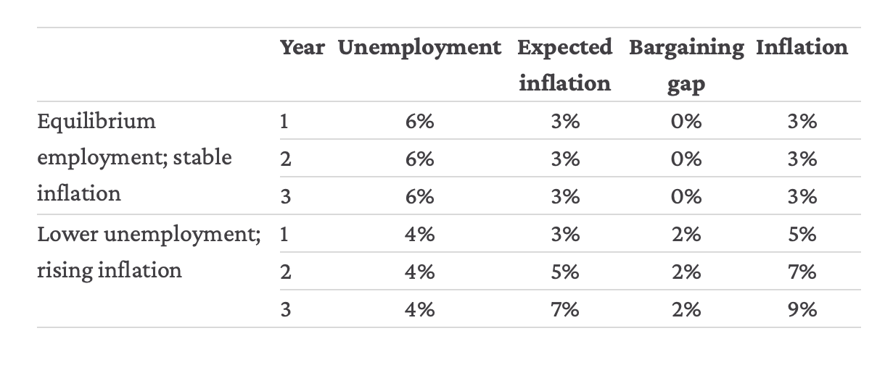
Expected inflation and the shifting Phillips curve

Slide 32
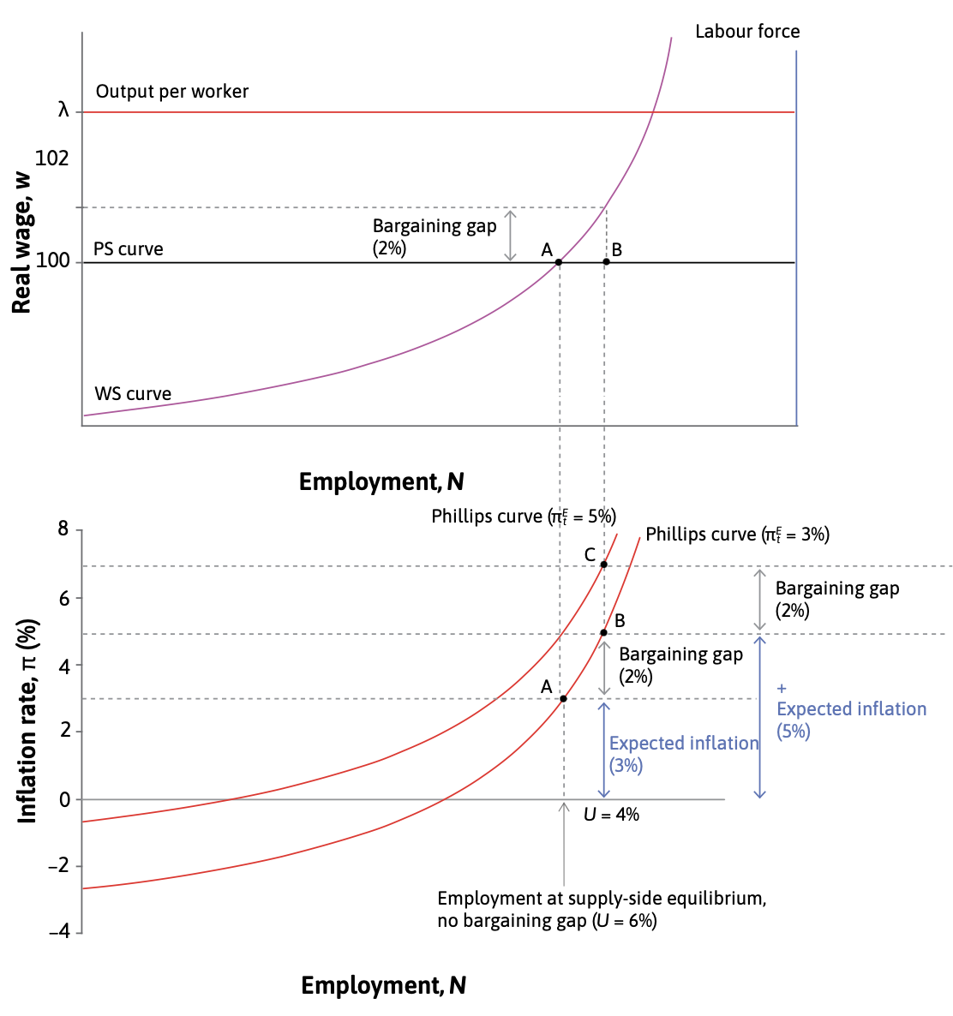
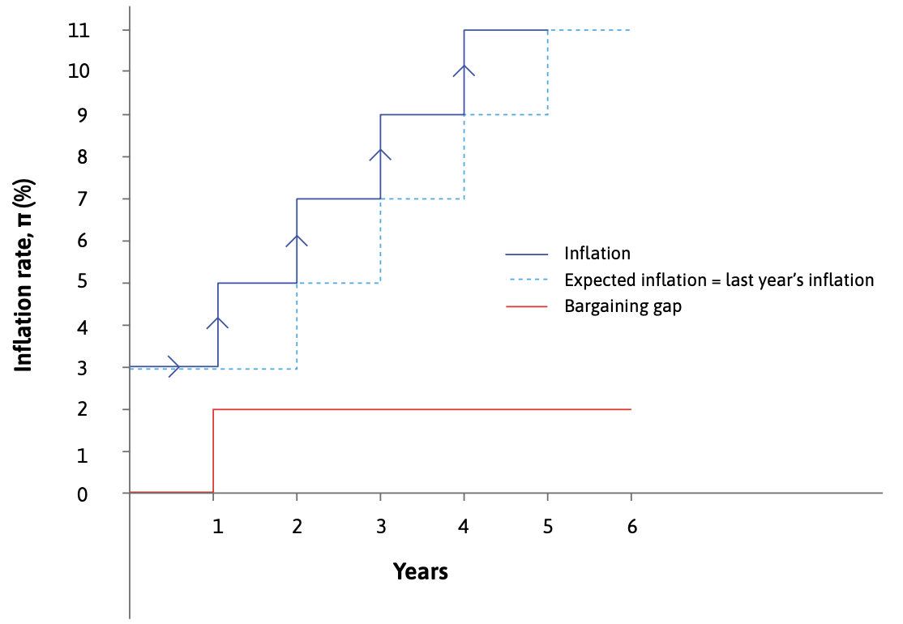
Expected inflation and the shifting Phillips curve

Slide 33
Expected inflation and the shifting Phillips curve
If expected inflation increases, the whole curve shifts up
Inflation today depends on:
Unemployment
Bargaining gap
Expected inflation

Slide 34
D. Causes of inflation

Slide 35
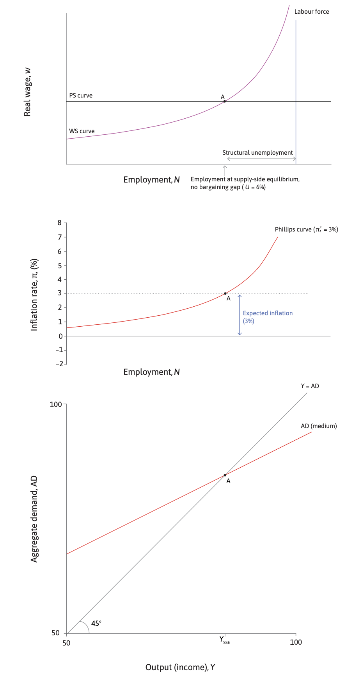
The business cycle model
To allow us to draw the demand-side model underneath the supply-side model, we simplify further, assuming λ = 1, and so Y = N.

Slide 36
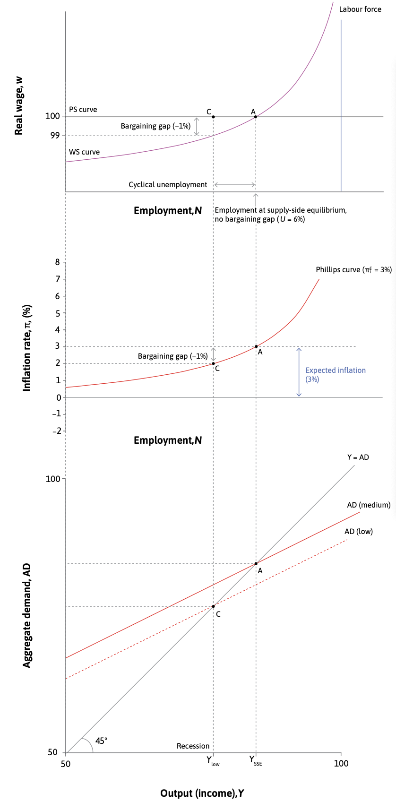
The business cycle model

Slide 37
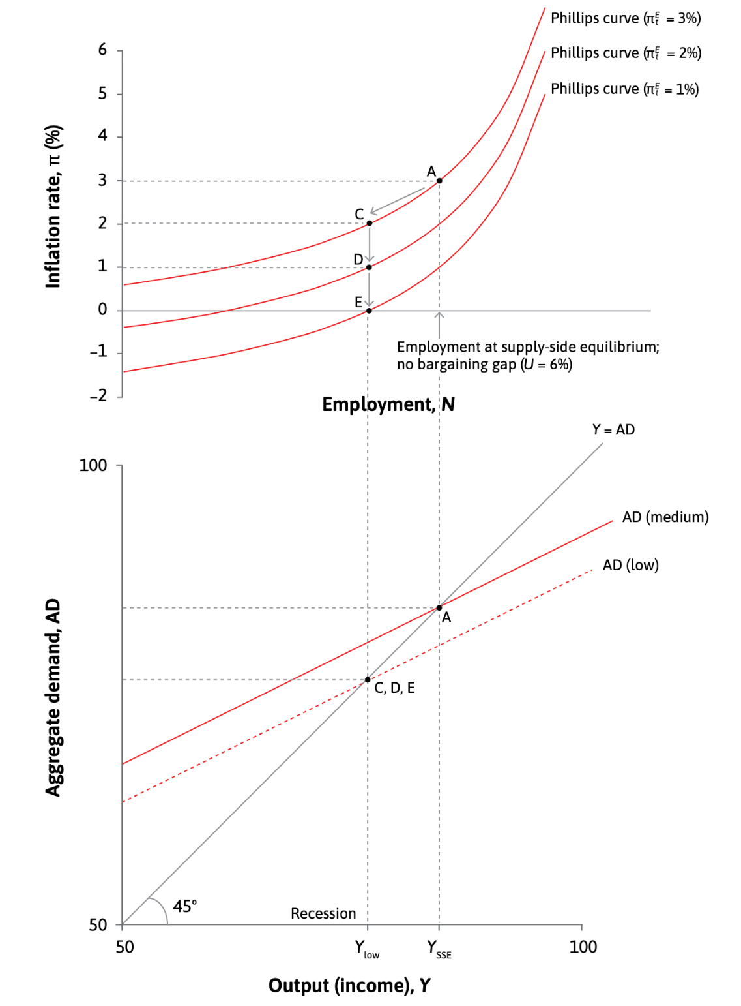
Fall in planned investment
Consider the impact of a fall in investment due to a broad-based fall in business confidence about the growth of markets and therefore about future expected profits.

Slide 38
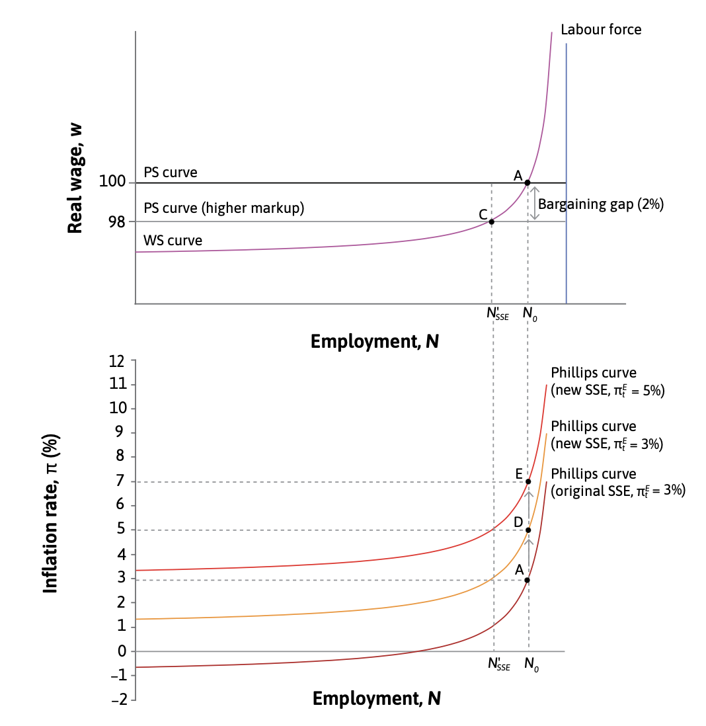
Increased market power of firms
The government adopts protectionist policies, which make it more difficult for foreign firms to enter its markets.

Slide 39
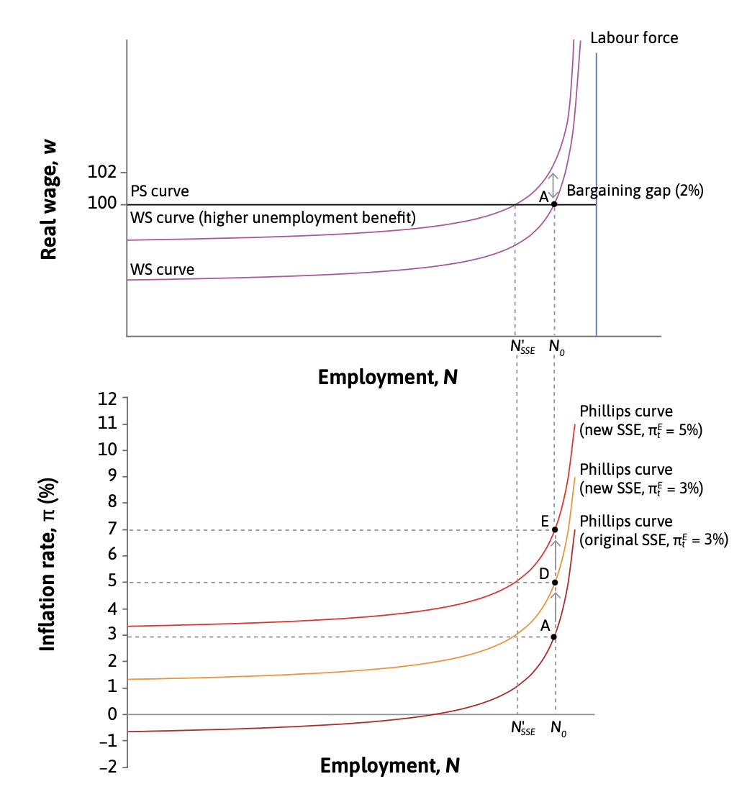
Increased union bargaining power
WS curve (stronger bargaining power)
Unions become stronger or withdraw bargaining restraint.

Slide 40
Causes of inflation
Starting at the inflation-stabilizing rate of unemployment, increased inflation can occur for two reasons:
An inflationary demand shock increases employment above the supply-side equilibrium, and thus introduces a bargaining gap which raises inflation.
An inflationary supply shock changes the supply-side equilibrium—either because the PS curve shifts down, lowering the real wage, or because the WS curve shifts up, increasing the real wage workers want (but do not get). As a result, a bargaining gap arises even if employment remains unchanged.

Slide 41
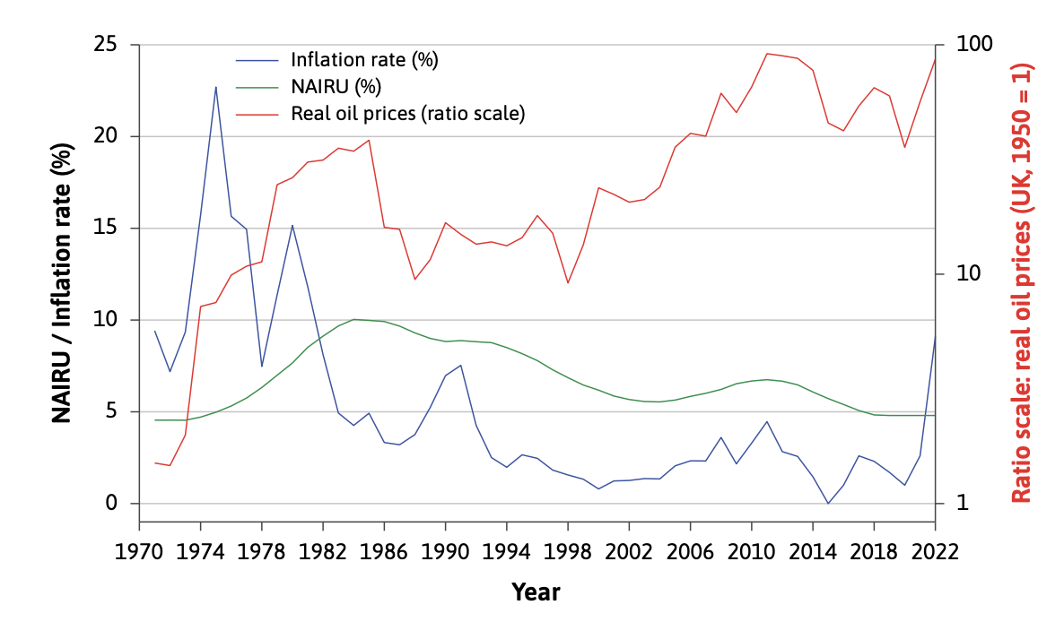
Global oil and other commodity price shocks

Slide 42
Global oil and other commodity price shocks
The WS–PS model and the Phillips curve can explain why a one-off increase in the world oil price can lead to a combination of:
higher structural unemployment
a rise in the price level (inflation) at the time of the shock, and
rising inflation.
A rise in the oil price shifts the price-setting curve down: this leads to higher structural unemployment, a positive bargaining gap at the pre-existing level of employment, and inflation. The Phillips curve will continue to shift up as expected inflation rises.

Slide 43
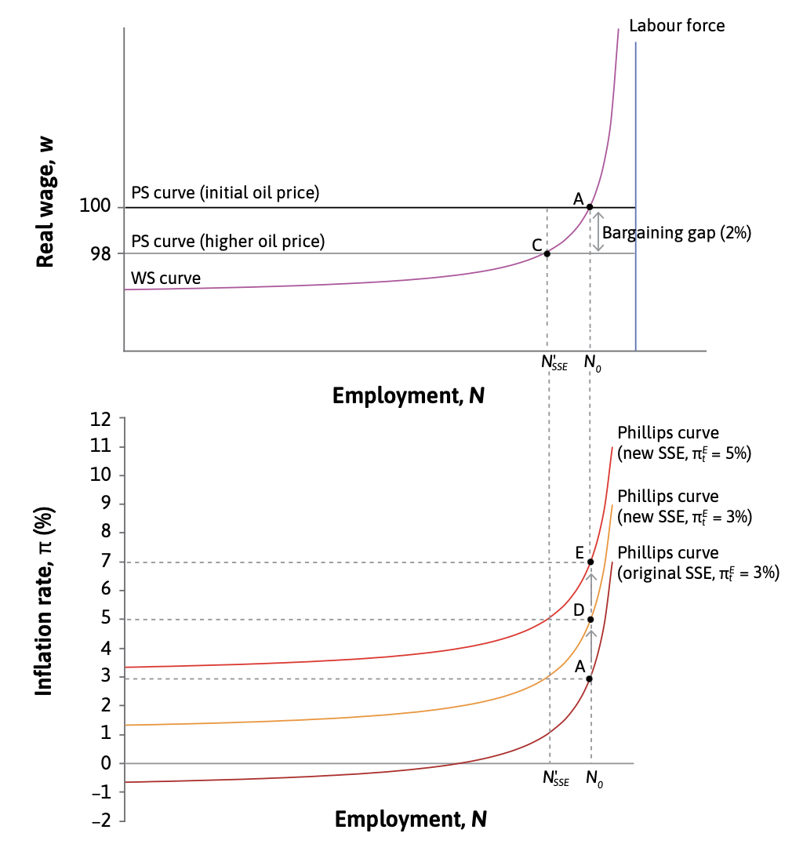
Global oil and other commodity price shocks
As long as employment remains at its pre-oil-shock level, inflation will increase every period. The model helps us to understand why a rise in the world price of such an important input to economic activity leads to rising inflation.

Slide 44
A review of the causes of inflation
Cost-push inflation could be the result of a rise in the price of imported oil, or an improvement in the labour market position of workers because of a rise in unemployment benefits or stronger legislation protecting the right to strike, for example. Whereas the oil price shock shifts the PS curve down, a rise in union bargaining power shifts the WS curve up.
Demand-pull inflation refers to a movement along a Phillips curve to a higher inflation rate because of a rise in aggregate demand, which we model with a shift in the AD curve in the multiplier model.
‘Expectations-driven’ inflation refers to a rise in inflation because of a shift of the Phillips curve due to a change in peoples’ expectations about inflation.

Slide 45
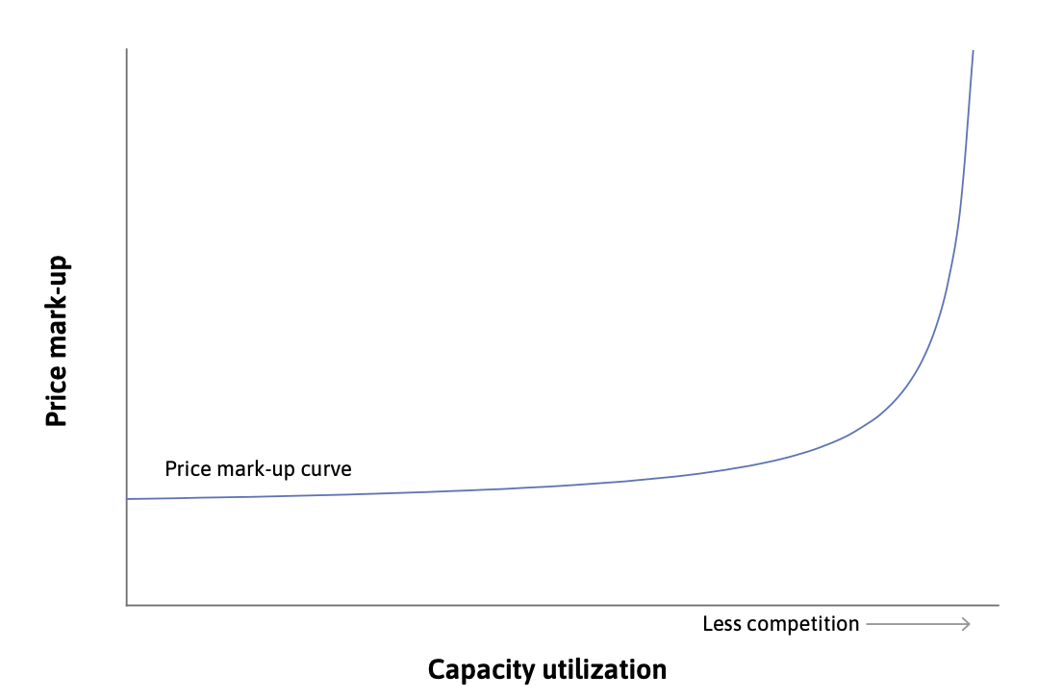
Profit-push or seller’s inflation
Our model suggests a fourth type of inflation, which we call ‘profit-push’ or ‘sellers’ inflation’.
When weaker competition in markets for goods and services increases the markup, the PS curve shifts down, opening up a bargaining gap. This triggers rising inflation.

Slide 46
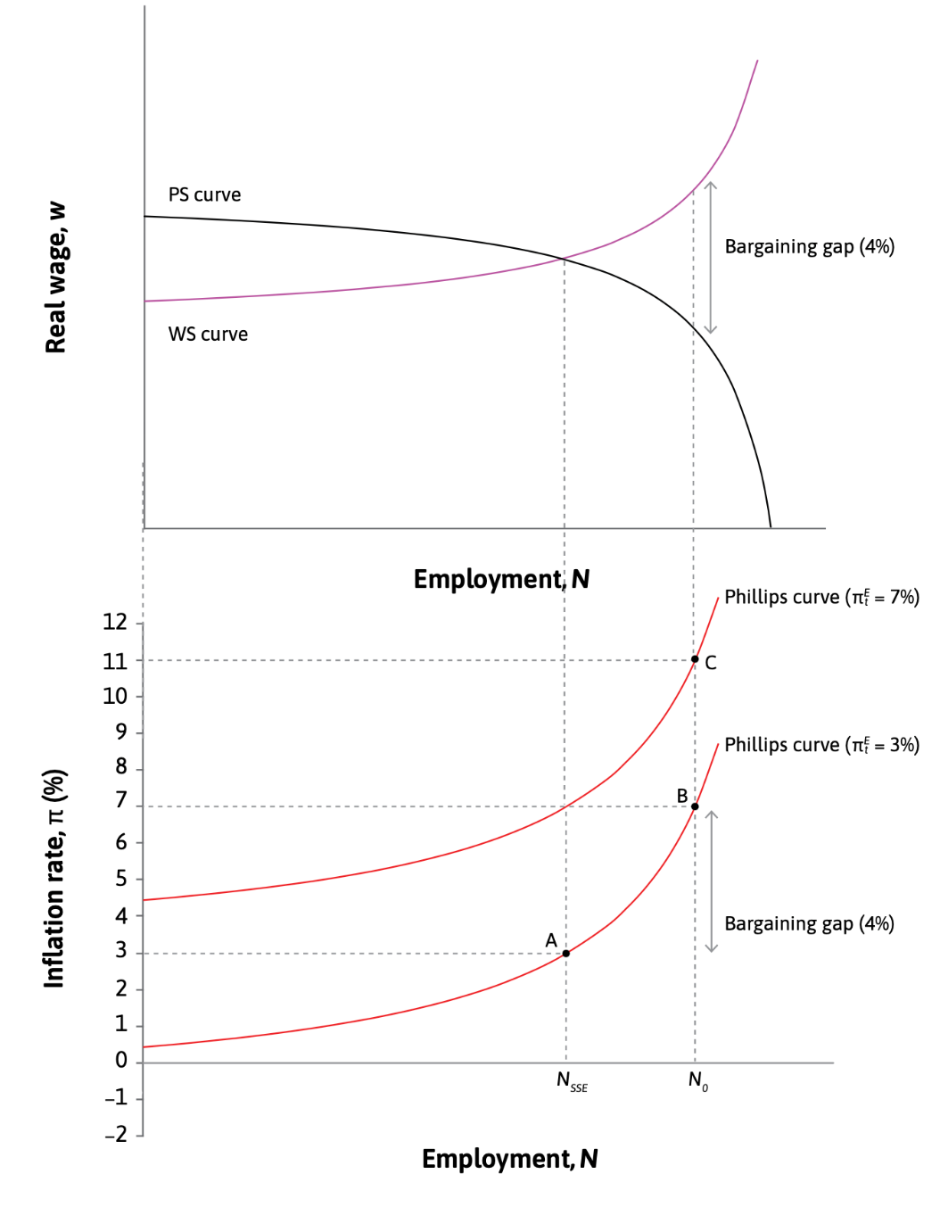
Profit-push or seller’s inflation
When firms can raise their markup as they become capacity constrained, the bargaining gap widens for two reasons:
the tightness of the labour market, and
capacity constraints encountered by firms.
This results in a steeper Phillips curve because of the combined effect of the upward-sloping WS curve and the downward-sloping PS curve.

Slide 47
Summary
Consumer price inflation is measured by the percentage increase in the cost of a representative basket of household goods and services, usually over a year.
We model inflation as a process in which firms ultimately set real wages. When WS > PS, workers want, and get, higher nominal wages because their position in the labour market is stronger but firms immediately raise prices so that real wages are unchanged (on the PS).
This results in the Phillips curve: inflation is driven by the bargaining gap between the real wage workers want (on the WS) and the wage that they receive (on the PS).
Inflation will continue to rise period by period if the bargaining gap persists and the expected rate of inflation rises, shifting the Phillips curve up.
The inflation-stabilizing rate of unemployment is given by the supply-side equilibrium where the WS and PS curves intersect—this is also termed the equilibrium or structural unemployment rate.

Slide 48
In the next unit
Discuss the difference between fiscal and monetary policy
Explain how fiscal and monetary policy tools can be used to limit the impact of shocks
Explain how policy responses and economic outcomes differ for demand shocks and supply shocks

